Slide 1
Database Systems
Lecture 3
Database System Concepts and Architecture
Chapter 2
Alina Arshad
alina.arshad@nu.edu.pk

Slide 2
Database System Utilities
Help the DBA to manage the database system.
Common utilities:
Loading:
Used to load existing data file i.e. text files or sequential files.
Current (source) format of the data file and the desired (target) database file structure are specified to the utility, which then automatically reformats the data and stores it in the database.
Backup:
Creates a backup copy of the database. , usually by dumping the entire database onto tape or other mass storage medium.
Incremental backups: Only changes since the previous backup are recorded
Notes:
Database System Utilities
database utilities that help the DBA manage the database system.
Common utilities have the following types of functions:
■ Loading. A loading utility is used to load existing data files—such as text files or sequential files—into the database. Usually, the current (source) format of the data file and the desired (target) database file structure are specified to the utility, which then automatically reformats the data and stores it in the database. With the proliferation of DBMSs, transferring data from one DBMS to another is becoming common in many organizations. Some vendors offer conversion tools that generate the appropriate loading programs, given the existing source and target database storage descriptions (internal schemas).
■ Backup. A backup utility creates a backup copy of the database, usually by dumping the entire database onto tape or other mass storage medium. The backup copy can be used to restore the database in case of catastrophic disk failure. Incremental backups are also often used, where only changes since the previous backup are recorded. Incremental backup is more complex, but saves storage space.
■ Database storage reorganization. This utility can be used to reorganize a set of database files into different file organizations and create new access paths to improve performance.
■ Performance monitoring. Such a utility monitors database usage and provides statistics to the DBA. The DBA uses the statistics in making decisions such as whether or not to reorganize files or whether to add or drop indexes to improve performance.
Other utilities may be available for sorting files, handling data compression, monitoring access by users, interfacing with the network, and performing other functions.

Slide 3
Database System Utilities
Database storage reorganization:
Reorganize a set of database files into different file organizations and create new access paths to improve performance.
Performance Monitoring:
Monitors database usage and provides statistics to the DBA.
DBA uses the statistics in making decisions
i.e. whether or not to reorganize files or whether to add or drop indexes to improve performance.
Other utilities: Sorting files, handling data compression, monitoring access by users, interfacing with the network, and performing other functions.

Slide 4
Classification Database Management Systems
Several criteria can be used to classify DBMSs.
1. Data model
Relational Data Model(SQL systems): commercial DBMSs
Big Data Systems/ Key-value Storage Systems/ Nosql Systems
Document-based
Graph-based
Column-based
Hierarchical Data Models: Legacy Data Models
Network Data Models: Legacy Data Models
Tree-structured Data Model: XML based

Slide 5
Classification Database Management Systems
2. Number of users supported by the system:
Single-user systems: support only one user at a time.
Multiuser systems. Multiple users at a time. Majority of databases are multiuser systems.
3. Number of sites over which the database is distributed.
Centralized: data is stored at a single computer site; can support multiple users.
Distributed DBMS (DDBMS): have the actual database and DBMS software distributed over many sites connected by a computer network. i.e. Big Data Systems
Notes:
Centralized: data is stored at a single computer site; can support multiple users.
Distributed DBMS (DDBMS): have the actual database and DBMS software distributed over many sites connected by a computer network.
Big data systems are often massively distributed, with hundreds of sites. The data is often replicated on multiple sites so that failure of a site will not make some data unavailable.

Slide 6
Classification Database Management Systems
Distributed DBMSs:
Homogeneous DDBMSs: same DBMS software at all the sites
Heterogeneous DDBMSs: use different DBMS software at each site.
4. The fourth criterion is cost.
Additional cost for accessing additional features. i.e. data warehousing, data mining, maintenance etc.
Examples of free relational DBMSs: MySQL, PostgreSQL, others
Notes:
It is also possible to develop middleware software to access several autonomous preexisting databases stored under heterogeneous DBMSs. This leads to a federated DBMS (or multi database system), in which the participating DBMSs are loosely coupled and have a degree of local autonomy.
Cost Range: from free open-source systems to configurations costing millions of dollars
Examples of free relational DBMSs: MySQL, PostgreSQL, others
Commercial DBMS offer additional specialized modules, e.g. time-series module, spatial data module, document module, XML module
These offer additional specialized functionality when purchased separately
Sometimes called cartridges or blades
Different licensing options: site license, maximum number of concurrent users (seat license), single user, etc.

Slide 7
Classification Database Management Systems
General purpose DBMSs: handle Wide range of applications
Special purpose DBMSs:
Use for specific application.
When performance is a primary consideration.
Also called online transaction processing (OLTP) systems.
i.e. Airline reservation.
Notes:
Finally, a DBMS can be general purpose or special purpose. When performance is a primary consideration, a special-purpose DBMS can be designed and built for a specific application; such a system cannot be used for other applications without major changes. Many airline reservations and telephone directory systems developed in the past are special-purpose DBMSs. These fall into the category of online transaction processing (OLTP) systems, which must support a large number of concurrent transactions without imposing excessive delays

Slide 8
Criteria 1 continued
Relational data model
Database as a collection of tables
Each table can be stored as a separate file
Uses SQL and support a limited form of user views
Object data model
defines a database in terms of objects, their properties, and their operations.
Objects with the same structure and behavior belong to a class
Classes are organized into hierarchies (or acyclic graphs).
Operations of each class are specified in terms of predefined procedures called methods
Notes:
Relational DBMSs have been extending their models to incorporate object database concepts and other capabilities; these systems are referred to as object-relational or extended relational systems.

Slide 9
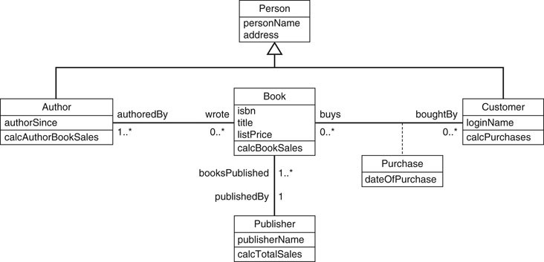
Object Data Model

Slide 10
Criteria 1 continued
Big data systems:
Key-Value:
Associates a unique key with each value
Provides very fast access to a value given its key.
Firebase from Google
Document Data Model
Stores the data as documents, which somewhat resemble complex objects.
Based on json (java script object notation)
i.e. MongoDB
Notes:
Big data systems are based on various data models, with the following four data models most common.
The key-value data model associates a unique key with each value (which can be a record or object) and provides very fast access to a value given its key.
The document data model is based on JSON (Java Script Object Notation) and stores the data as documents, which somewhat resemble complex objects.
The graph data model stores objects as graph nodes and relationships among objects as directed graph edges.
Finally, the column-based data models store the columns of rows clustered on disk pages for fast access and allow multiple versions of the data.

Slide 11
Criteria 1 continued
Graph Data Model
Stores objects as graph nodes and relationships among objects as directed graph edges.
i.e. Neo4j
Column-based Data Models
Store the columns of rows clustered on disk pages for fast access
Allow multiple versions of the data.
i.e. Hbase

Slide 12
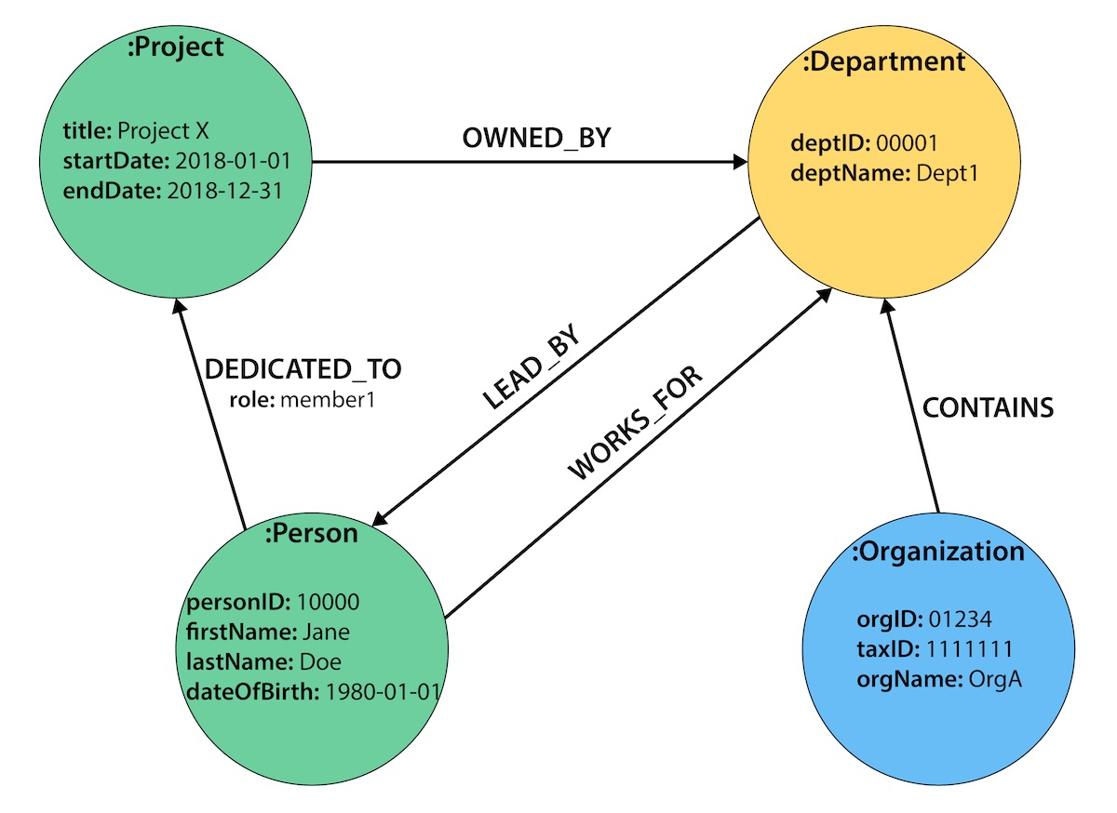
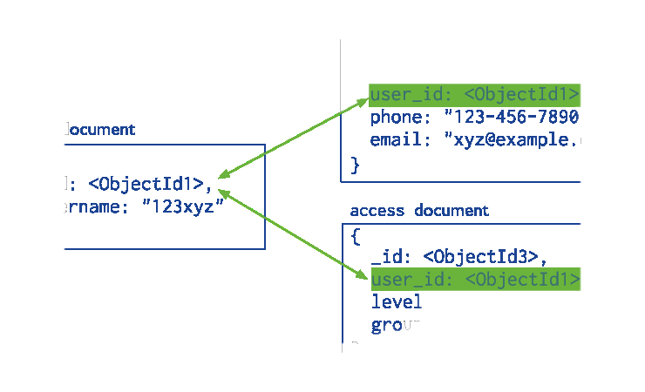
Document Model
Graph Data Model
Account number | Last name | First name | Purchase (in dollars)
0411 | Moriarty | Angela | 52.35
0412 | Richards | Jason | 325.82
0413 | Diamond | Samantha | 25.50
Column data model

Slide 13
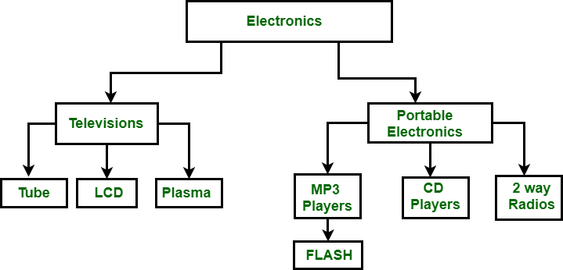
Legacy Data Models
Hierarchical Data Model :
It organizes data in the tree-like structure.
Hierarchical model consists of the following :
It contains nodes which are connected by branches.
The topmost node is called the root node.
If there are multiple nodes appear at the top level, then these can be called as root segments.
Each node has exactly one parent.
One parent may have many child.

Slide 14
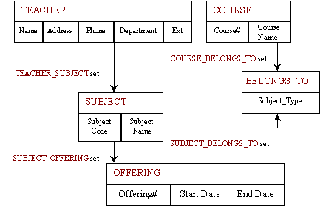
Legacy Data Models
Network Data Model :
It is the advance version of the hierarchical data model.
In this child can have more than one parent.

Slide 15
Tools, Application Environments, and Communications Facilities
CASE tools: used in the design phase of database systems.
Data dictionary(information repository): storing catalog information about schemas and constraints, design decisions, usage standards, application program descriptions, and user information
Application development environment:
PowerBuilder (Sybase) or JBuilder (Borland) including database design, GUI development, querying and updating, and application program development.
Communications Facilities:
Provided using data communications hardware such as Internet routers, phone lines, long-haul networks, local networks, or satellite communication devices.
Notes:
Other tools are often available to database designers, users, and the DBMS. CASE tools are used in the design phase of database systems. Another tool that can be quite useful in large organizations is an expanded data dictionary (or data repository) system. In addition to storing catalog information about schemas and constraints, the data dictionary stores other information, such as design decisions, usage standards, application program descriptions, and user information. Such a system is also called an information repository. This information can be accessed directly by users or the DBA when needed. A data dictionary utility is similar to the DBMS catalog, but it includes a wider variety of information and is accessed mainly by users rather than by the DBMS software.
Application development environments, such as PowerBuilder (Sybase) or JBuilder (Borland), have been quite popular. These systems provide an environment for developing database applications and include facilities that help in many facets of database systems, including database design, GUI development, querying and updating, and application program development.
The DBMS also needs to interface with communications software, whose function is to allow users at locations remote from the database system site to access the database through computer terminals, workstations, or personal computers. These are connected to the database site through data communications hardware such as Internet routers, phone lines, long-haul networks, local networks, or satellite communication devices. Many commercial database systems have communication packages that work with the DBMS. The integrated DBMS and data communications system is called a DB/DC system. In addition, some distributed DBMSs are physically distributed over multiple machines. In this case, communications networks are needed to connect the machines. These are often local area networks (LANs), but they can also be other types of networks.

Slide 16
Any question????

